Slide 1
C PROGRAMMING
Michael D’Argenio – mjdargen@ncsu.edu
Electrical Engineering – SS 2019 – Duke TIP

Slide 2
INTRO TO C PROGRAMMING

Slide 3
C: A High-Level Language
Gives symbolic names to values
don’t need to know which register or memory location
Provides abstraction of underlying hardware
operations do not depend on instruction set
example: can write “a = b * c”, even though architecture may not have a multiply instruction
Provides expressiveness
use meaningful symbols that convey meaning
simple expressions for common control patterns (if-then-else)
Enhances code readability
Safeguards against bugs
can enforce rules or conditions at compile-time or run-time

Slide 4
Compilation vs. Interpretation
Different ways of translating high-level language
Interpretation
interpreter = program that executes program statements
generally one line/command at a time
limited processing
easy to debug, make changes, view intermediate results
languages: BASIC, LISP, Perl, Java, Matlab, C-shell
Compilation
translates statements into machine language
does not execute, but creates executable program
performs optimization over multiple statements
change requires recompilation

Slide 5
Compilation vs. Interpretation
Consider the following algorithm:
Get W from the keyboard.
X = W + W
Y = X + X
Z = Y + Y
Print Z to screen.
If interpreting, how many arithmetic operations occur?
If compiling, we can analyze the entire program and possibly reduce the number of operations. Can we simplify the above algorithm to use a single arithmetic operation?

Slide 6
Compiling a C Program
Entire mechanism is usually called the “compiler”
Preprocessor
macro substitution
conditional compilation
“source-level” transformations
output is still C
Compiler
generates object file
machine instructions
Linker
combine object files (including libraries) into executable image

Slide 7
Compiler
Source Code Analysis or “front end”
parses programs to identify its pieces (variables, expressions, statements, functions, etc.)
depends on language (not on target machine)
Code Generation or “back end”
generates machine code from analyzed source
may optimize machine code to make it run more efficiently
very dependent on target machine
Symbol Table
map between symbolic names and items
like assembler, but more kinds of information

Slide 8
A Simple C Program
#include <stdio.h>
#define STOP 0
/* Function: main */
/* Description: counts down from user input to STOP */
main()
{
/* variable declarations */
int counter; /* an integer to hold count values */
int startPoint; /* starting point for countdown */
/* prompt user for input */
printf("Enter a positive number: ");
scanf("%d", &startPoint); /* read into startPoint */
/* count down and print count */
for (counter=startPoint; counter >= STOP; counter--)
printf("%d\n", counter);
}

Slide 9
Preprocessor Directives
#include <stdio.h>
Before compiling, copy contents of header file (stdio.h) into source code.
Header files typically contain descriptions of functions and variables needed by the program.
no restrictions -- could be any C source code
#define STOP 0
Before compiling, replace all instances of the string "STOP" with the string "0"
Called a macro
Used for values that won't change during execution, but might change if the program is reused. (Must recompile.)

Slide 10
Comments
Comments are used to help reader and yourself!
Single line or inline comments
Begin with //
No end marker
Multi-line or block comments
Begins with /* and ends with */
Can span multiple lines
Cannot have a comment within a comment
Comments are not recognized within a string (meaning in “”)
example: "my/*don't print this*/string“ would be printed as: my/*don't print this*/string

Slide 11
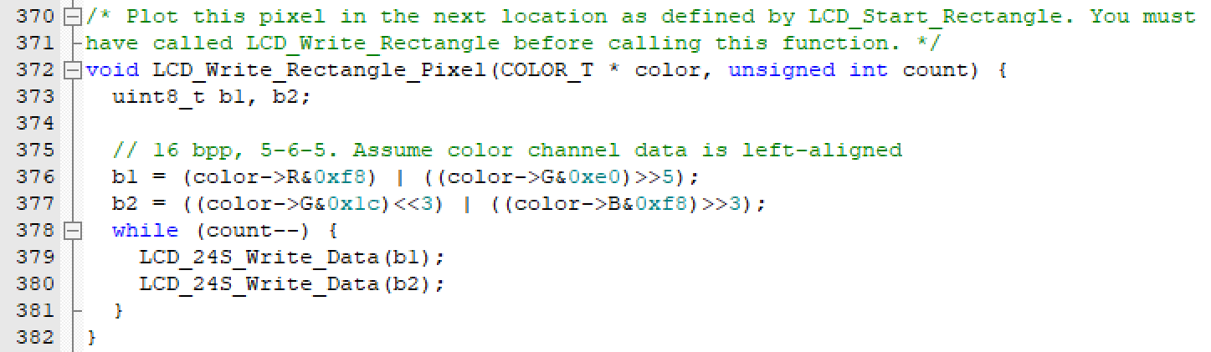
Comments Example

Slide 12
main Function
Every C program must have a function called main().
This is the code that is executed when the program is run.
The code for the function lives within brackets:
void main()
{
/* code goes here */
}

Slide 13
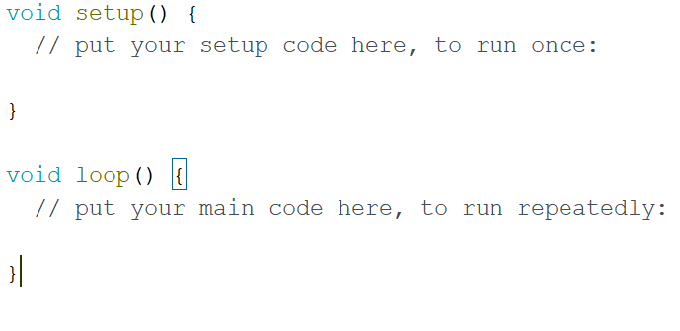
*Special Note for Arduino
Every C program must have a function called main().
However, Arduino has created an abstraction and instead has a setup() and loop() functions.
This is what it looks like behind the scenes:
void main()
{
setup();
while (1)
{
loop();
}
}

Slide 14
Variable Declarations
Variables are used as names for data items.
Each variable has a type, which tells the compiler how the data is to be interpreted (and how much space it needs, etc.).
int counter;
int startPoint;
int is a predefined integer type in C.

Slide 15
Input and Output
Variety of I/O functions in C Standard Library.
Must include <stdio.h> to use them.
printf("%d\n", counter);
String contains characters to print and formatting directions for variables.
This call says to print the variable counter as a decimal integer, followed by a linefeed (\n).
scanf("%d", &startPoint);
String contains formatting directions for looking at input.
This call says to read a decimal integer and assign it to the variable startPoint. (Don't worry about the & yet.)

Slide 16
More About Output
Can print arbitrary expressions, not just variables
printf("%d\n", startPoint - counter);
Print multiple expressions with a single statement
printf("%d %d\n", counter, startPoint - counter);
Different formatting options:
%d decimal integer
%x hexadecimal integer
%c ASCII character
%f floating-point number

Slide 17
Examples
This code:
printf("%d is a prime number.\n", 43);
printf("43 plus 59 in decimal is %d.\n", 43+59);
printf("43 plus 59 in hex is %x.\n", 43+59);
printf("43 plus 59 as a character is %c.\n", 43+59);
Produces this output:
43 is a prime number.
43 + 59 in decimal is 102.
43 + 59 in hex is 66.
43 + 59 as a character is f.

Slide 18
Examples of Input
Many of the same formatting characters are available for user input.
scanf("%c", &nextChar);
reads a single character and stores it in nextChar
scanf("%f", &radius);
reads a floating point number and stores it in radius
scanf("%d %d", &length, &width);
reads two decimal integers (separated by whitespace), stores the first one in length and the second in width
Must use ampersand (&) for variables being modified. * explained later

Slide 19
Compiling and Linking
Various compilers available
cc, gcc
includes preprocessor, compiler, and linker
Lots and lots of options!
level of optimization, debugging
preprocessor, linker options
intermediate files -- object (.o), assembler (.s), preprocessor (.i), etc.

Slide 20
VARIABLES

Slide 21
Basic C Elements
Variables
named, typed data items
Operators
predefined actions performed on data items
combined with variables to form expressions, statements

Slide 22
Data Types
C has three basic data types:
int integer (16 bits)
double floating point (32 bits)
char character (8 bits)

Slide 23
Variable Names
Any combination of letters, numbers, and underscore (_)
Case matters
"sum" is different than "Sum"
Cannot begin with a number
usually, variables beginning with underscore are used only in special library routines
31 character limit to variable names

Slide 24
Examples
Legal
i wordsPerSecond words_per_second _green aReally_longName_moreThan31chars aReally_longName_moreThan31characters
Illegal
10sdigit ten'sdigit done? double
same identifier
reserved keyword

Slide 25
Literals
Integer
123 /* decimal */
-123
0x123 /* hexadecimal */
Floating point
6.023
6.023e23 /* 6.023 x 10²³ */
5E12 /* 5.0 x 10¹² */
Character
‘c’
'\n' /* newline */
'\xA' /* ASCII 10 (0xA) */

Slide 26
Scope: Global and Local
Where is the variable accessible?
Global: accessed anywhere in program
Local: only accessible in a particular region
Compiler infers scope from where variable is declared
programmer doesn't have to explicitly state
Variable is local to the block in which it is declared
block defined by open and closed braces { }
can access variable declared in any "containing" block
Global variable is declared outside all blocks

Slide 27
Example
#include <stdio.h>
int itsGlobal = 0;
main(){
int itsLocal = 1; /* local to main */
printf("Global %d Local %d\n", itsGlobal, itsLocal);
{
int itsLocal = 2; /* local to this block */
itsGlobal = 4; /* change global variable */
printf("Global %d Local %d\n", itsGlobal, itsLocal);
}
printf("Global %d Local %d\n", itsGlobal, itsLocal);
}
Output
Global 0 Local 1 Global 4 Local 2 Global 4 Local 1

Slide 28
OPERATIONS

Slide 29
Operators
Programmers manipulate variables using the operators provided by the high-level language.
Variables and operators combine to form expressions and statements which denote the work to be done by the program.
Each operator may correspond to many machine instructions.
Example: The multiply operator (*) typically requires multiple ADD instructions. (multiply is not always supported)

Slide 30
Expression
Any combination of variables, constants, operators, and function calls
every expression has a type, derived from the types of its components (according to C typing rules)
Examples:
counter >= STOP
x + sqrt(y)
x & z + 3 || 9 - w-- % 6

Slide 31
Statement
Expresses a complete unit of work
executed in sequential order
Simple statement ends with semicolon
z = x * y; /* assign product to z */
y = y + 1; /* after multiplication */
; /* null statement */
Compound statement groups simple statements using braces.
syntactically equivalent to a simple statement
{ z = x * y; y = y + 1; }

Slide 32
Operators
Three things to know about each operator
(1) Function
what does it do?
(2) Precedence
in which order are operators combined?
Example: "a * b + c * d" is the same as "(a * b) + (c * d)" because multiply (*) has a higher precedence than addition (+)
(3) Associativity
in which order are operators of the same precedence combined?
Example: "a - b - c" is the same as "(a - b) - c" because add/sub associate left-to-right

Slide 33
Assignment Operator
Changes the value of a variable.
x = x + 4;
1. Evaluate right-hand side.
2. Set value of left-hand side variable to result.

Slide 34
Assignment Operator
All expressions evaluate to a value, even ones with the assignment operator.
For assignment, the result is the value assigned.
usually (but not always) the value of the right-hand side
type conversion might make assigned value different than computed value
Assignment associates right to left.
y = x = 3;
y gets the value 3, because (x = 3) evaluates to the value 3.

Slide 35
Arithmetic Operators
Symbol Operation Usage Precedence Assoc
* multiply x * y 6 l-to-r
/ divide x / y 6 l-to-r
% modulo x % y 6 l-to-r
+ addition x + y 7 l-to-r
- subtraction x - y 7 l-to-r
All associate left to right.
* / % have higher precedence than + -.

Slide 36
Arithmetic Expressions
If mixed types, smaller type is "promoted" to larger.
x + 4.3 if x is int, converted to double and result is double
Integer division -- fraction is dropped.
x / 3 if x is int and x=5, result is 1 (not 1.666666...)
Modulo -- result is remainder.
x % 3
if x is int and x=5, result is 2.

Slide 37
Bitwise Operators
Symbol Operation Usage Precedence Assoc
~ bitwise NOT ~x 4 r-to-l
<< left shift x << y 8 l-to-r
>> right shift x >> y 8 l-to-r
& bitwise AND x & y 11 l-to-r
^ bitwise XOR x ^ y 12 l-to-r
| bitwise OR x | y 13 l-to-r
Operate on variables bit-by-bit.
Like LC-3 AND and NOT instructions.
Shift operations are logical (not arithmetic). Operate on values -- neither operand is changed.

Slide 38
Logical Operators
Symbol Operation Usage Precedence Assoc
! logical NOT !x 4 r-to-l
&& logical AND x && y 14 l-to-r
|| logical OR x || y 15 l-to-r
Treats entire variable (or value) as TRUE (non-zero) or FALSE (zero).
Result is 1 (TRUE) or 0 (FALSE).

Slide 39
Relational Operators
Symbol Operation Usage Precedence Assoc
> greater than x > y 9 l-to-r
>= greater than or equal x >= y 9 l-to-r
< less than x < y 9 l-to-r
<= less than or equal x <= y 9 l-to-r
== equal x == y 10 l-to-r
!= not equal x != y 10 l-to-r
Result is 1 (TRUE) or 0 (FALSE).
Note: Don't confuse equality (==) with assignment (=).

Slide 40
Special Operators: ++ and --
Changes value of variable before (or after) its value is used in an expression.
Symbol Operation Usage Precedence Assoc
++ postincrement x++ 2 r-to-l
-- postdecrement x-- 2 r-to-l
++ preincrement ++x 3 r-to-l
<= predecrement --x 3 r-to-l
Pre: Increment/decrement variable before using its value.
Post: Increment/decrement variable after using its value.

Slide 41
Using ++ and --
x = 4;
y = x++;
Results: x = 5, y = 4 (because x is incremented after assignment)
x = 4;
y = ++x;
Results: x = 5, y = 5 (because x is incremented before assignment)

Slide 42
Practice with Precedence
Assume a=1, b=2, c=3, d=4.
x = a * b + c * d / 2; /* x = 8 */
same as:
x = (a * b) + ((c * d) / 2);
For long or confusing expressions, use parentheses, because reader might not have memorized precedence table.
Note: Assignment operator has lowest precedence, so all the arithmetic operations on the right-hand side are evaluated first.

Slide 43
Symbol Table
Like assembler, compiler needs to know information associated with identifiers.
In assembler, all identifiers were labels and information is address
Compiler keeps more information
Name (identifier)
Type
Location in memory
Scope
Name
Type
Offset
Scope
amount
hours
minutes
rate
seconds
time
int
int
int
int
int
int
0
-3
-4
-1
-5
-2
main
main
main
main
main
main

Slide 44
Local Variable Storage
Local variables are stored in an activation record, also known as a stack frame.
Symbol table “offset” gives the distance from the base of the frame.
R5 is the frame pointer – holds address of the base of the current frame.
A new frame is pushed on the run-time stack each time a block is entered.
Because stack grows downward, base is the highest address of the frame, and variable offsets are <= 0.
seconds
minutes
hours
time
rate
amount
R5

Slide 45
Allocating Space for Variables
Global data section
All global variables stored here (actually all static variables)
R4 points to beginning
Run-time stack
Used for local variables
R6 points to top of stack
R5 points to top frame on stack
New frame for each block (goes away when block exited)
Offset = distance from beginning of storage area
Global: LDR R1, R4, #4
Local: LDR R2, R5, #-3
0x0000
instructions
PC
R4
global data
R6
run-time
stack
R5
0xFFFF

Slide 46
Variables and Memory Locations
In our examples, a variable is always stored in memory.
When assigning to a variable, must store to memory location.
A real compiler would perform code optimizations that try to keep variables allocated in registers.
Why?

Slide 47
Example: Compiling to LC-3
#include <stdio.h>
int inGlobal;
main()
{
int inLocal; /* local to main */
int outLocalA;
int outLocalB;
/* initialize */
inLocal = 5;
inGlobal = 3;
/* perform calculations */
outLocalA = inLocal++ & ~inGlobal;
outLocalB = (inLocal + inGlobal) - (inLocal - inGlobal);
/* print results */
printf("The results are: outLocalA = %d, outLocalB = %d\n",
outLocalA, outLocalB);
}

Slide 48
Example: Symbol Table
Name | Type | Offset | Scope
inGlobal | int | 0 | global
inLocal | int | 0 | main
outLocalA | int | -1 | main
outLocalB | int | -2 | main

Slide 49
Example: Code Generation
; main
; initialize variables
AND R0, R0, #0 ADD R0, R0, #5 ; inLocal = 5 STR R0, R5, #0 ; (offset = 0) AND R0, R0, #0 ADD R0, R0, #3 ; inGlobal = 3 STR R0, R4, #0 ; (offset = 0)

Slide 50
Example (continued)
; first statement:
; outLocalA = inLocal++ & ~inGlobal;
LDR R0, R5, #0 ; get inLocal ADD R1, R0, #1 ; increment STR R1, R5, #0 ; store LDR R1, R4, #0 ; get inGlobal NOT R1, R1 ; ~inGlobal AND R2, R0, R1 ; inLocal & ~inGlobal STR R2, R5, #-1 ; store in outLocalA ; (offset = -1)

Slide 51
Example (continued)
; next statement:
; outLocalB = (inLocal + inGlobal) ; - (inLocal - inGlobal);
LDR R0, R5, #0 ; inLocal LDR R1, R4, #0 ; inGlobal ADD R0, R0, R1 ; R0 is sum LDR R2, R5, #0 ; inLocal LDR R3, R5, #0 ; inGlobal NOT R3, R3 ADD R3, R3, #1 ADD R2, R2, R3 ; R2 is difference NOT R2, R2 ; negate ADD R2, R2, #1 ADD R0, R0, R2 ; R0 = R0 - R2 STR R0, R5, #-2 ; outLocalB (offset = -2)

Slide 52
Special Operators: +=, *=, etc.
Arithmetic and bitwise operators can be combined with assignment operator.
Statement Equivalent assignment
x += y; x = x + y;
x -= y; x = x - y;
x *= y; x = x * y;
x /= y; x = x / y;
x %= y; x = x % y;
x &= y; x = x & y;
x |= y; x = x | y;
x ^= y; x = x ^ y;
x <<= y; x = x << y;
x >>= y; x = x >> y;
All have same precedence and
associativity as =
and associate
right-to-left.

Slide 53
Special Operator: Conditional
Symbol Operation Usage Precedence Assoc
?: conditional x?y:z 16 l-to-r
If x is TRUE (non-zero), result is y; else, result is z.
Like a MUX, with x as the select signal.
y
z
1
0
x

Slide 54
CONTROL STRUCTURES

Slide 55
Control Structures
Conditional - making a decision about which code to execute, based on evaluated expression
if
if-else
switch
Iteration - executing code multiple times, ending based on evaluated expression
while
for
do-while

Slide 56
If
if (condition) action;
Condition is a C expression, which evaluates to TRUE (non-zero) or FALSE (zero).
Action is a C statement, which may be simple or compound (a block).
condition
F
T
action
Condition is a C expression,
which evaluates to TRUE (non-zero) or FALSE (zero).
Action is a C statement, which may be simple or compound (a block).

Slide 57
Example If Statements
if (x <= 10)
y = x * x + 5;
if (x <= 10) { y = x * x + 5;
z = (2 * y) / 3; }
if (x <= 10)
y = x * x + 5;
z = (2 * y) / 3;
compound statement;
both executed if x <= 10
only first statement is conditional;
second statement is always executed

Slide 58
More If Examples
if (0 <= age && age <= 11) kids += 1;
if (month == 4 || month == 6 || month == 9 || month == 11) printf(“The month has 30 days.\n”);
if (x = 2) y = 5;
This is a common programming error (= instead of ==), not caught by compiler because it’s syntactically correct.
always true, so action is always executed!

Slide 59
If’s Can Be Nested
The following two statements are the same:
if (x == 3) { if (y != 6) { z = z + 1; w = w + 2;
}
}
if ((x == 3) && (y != 6)){ z = z + 1; w = w + 2; }

Slide 60
If-else
if (condition) action_if; else action_else;
Else allows choice between two mutually exclusive actions without re-testing condition.
T
condition
F
action_if
action_else

Slide 61
Matching Else with If
Else is always associated with closest unassociated if.
if (x != 10) if (y > 3) z = z / 2; else
z = z * 2;
is the same as...
is NOT the same as...
if (x != 10) { if (y > 3) z = z / 2; else z = z * 2;
}
if (x != 10) { if (y > 3) z = z / 2;
} else z = z * 2;

Slide 62
Chaining If’s and Else’s
if (month == 4 || month == 6 || month == 9 || month == 11) printf(“Month has 30 days.\n”); else if (month == 1 || month == 3 || month == 5 || month == 7 || month == 8 || month == 10 || month == 12) printf(“Month has 31 days.\n”);
else if (month == 2)
printf(“Month has 28 or 29 days.\n”);
else
printf(“Don’t know that month.\n”);

Slide 63
While
while (test) loop_body;
Executes loop body as long as test evaluates to TRUE (non-zero).
Note: Test is evaluated before executing loop body.
test
F
T
loop_body

Slide 64
Infinite Loops
The following loop will never terminate:
x = 0; while (x < 10) printf(“%d ”, x);
Loop body does not change condition, so test never fails.
This is a common programming error that can be difficult to find.

Slide 65
For
for (init; end-test; re-init) statement
Executes loop body as long as test evaluates to TRUE (non-zero). Initialization and re-initialization code included in loop statement.
Note: Test is evaluated before executing loop body
init
F
test
T
loop_body
re-init

Slide 66
Example For Loops
/* -- what is the output of this loop? -- */
for (i = 0; i <= 10; i ++) printf("%d ", i);
/* -- what does this one output? -- */
letter = 'a';
for (c = 0; c < 26; c++) printf("%c ", letter+c);
/* -- what does this loop do? -- */
numberOfOnes = 0; for (bitNum = 0; bitNum < 16; bitNum++) { if (inputValue & (1 << bitNum)) numberOfOnes++; }

Slide 67
Nested Loops
Loop body can (of course) be another loop.
/* print a multiplication table */
for (mp1 = 0; mp1 < 10; mp1++) { for (mp2 = 0; mp2 < 10; mp2++) { printf(“%d\t”, mp1*mp2); } printf(“\n”);
}
Braces aren’t necessary, for single line loops but they make the code easier to read.

Slide 68
Another Nested Loop
The test for the inner loop depends on the counter variable of the outer loop.
for (outer = 1; outer <= input; outer++) { for (inner = 0; inner < outer; inner++) { sum += inner; } }

Slide 69
For vs. While
In general:
For loop is preferred for counter-based loops.
Explicit counter variable
Easy to see how counter is modified each loop
While loop is preferred for sentinel-based loops.
Test checks for sentinel value.
Either kind of loop can be expressed as the other, so it’s really a matter of style and readability.

Slide 70
Do-While
do loop_body;
while (test);
Executes loop body as long as test evaluates to TRUE (non-zero).
Note: Test is evaluated after executing loop body.
loop_body
test
T
F

Slide 71
Problem Solving in C
Same basic constructs
Sequential -- C statements
Conditional -- if-else, switch
Iterative -- while, for, do-while

Slide 72

Problem 1: Calculating Pi
Calculate π using its series expansion. User inputs number of terms.
$$π=4−\frac{4}{3}+\frac{4}{5}−\frac{4}{7}+⋯+(−1)^{n−1}\frac{4}{2n+1}+⋯$$
Start
Evaluate Series
Initialize
Output
Results
Get Input
Stop

Slide 73
Pi: 1st refinement
Start
Initialize
iteration count
Initialize
for loop
count<terms
F
Get Input
T
Evaluate Series
Evaluate
next term
Output
Results
count = count+1
Stop

Slide 74
Pi: 2nd refinement
Initialize
iteration count
count is odd
T
F
count<terms
F
subtract term
add term
T
Evaluate
next term
add term
count = count+1
if-else

Slide 75
Pi: Code for Evaluate Terms
for (count=0; count < numOfTerms; count++) { if (count % 2) { /* odd term -- subtract */ pi -= 4.0 / (2 * count + 1); } else {
/* even term -- add */ pi += 4.0 / (2 * count + 1); }
}
Note: Code in text is slightly different, but this code corresponds to equation.

Slide 76
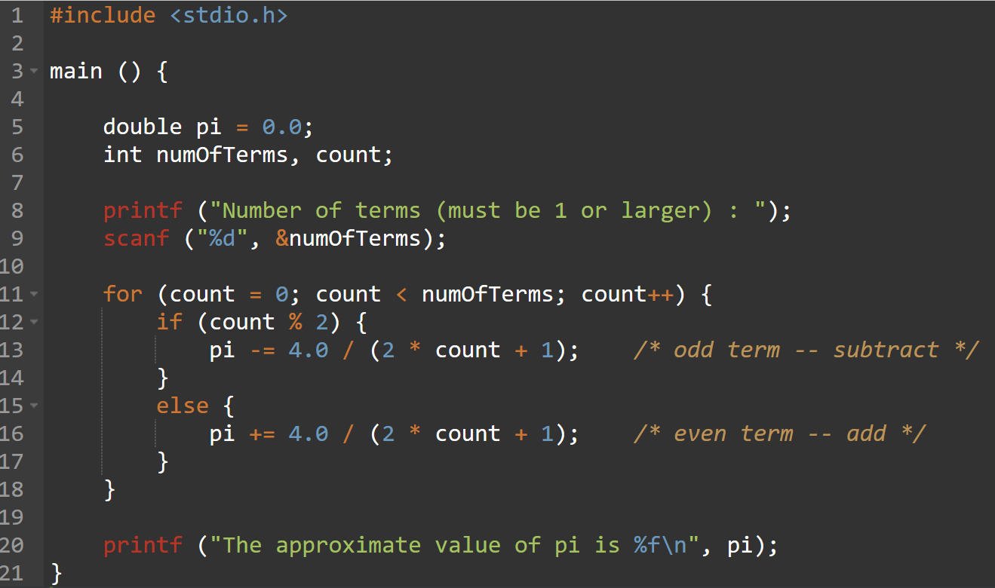
Pi: Complete Code

Slide 77
Problem 2: Finding Prime Numbers
Print all prime numbers less than 100.
A number is prime if its only divisors are 1 and itself.
All non-prime numbers less than 100 will have a divisor between 2 and 10.
Start
Initialize
Print primes
Stop

Slide 78
Primes: 1st refinement
Initialize
num = 2
Start
num < 100
F
Initialize
T
Print primes
Print num if prime
Stop
num = num + 1

Slide 79
Primes: 2nd refinement
Initialize
num = 2
Divide num by 2 through 10
num < 100
F
no divisors?
F
T
Print num if prime
T
Print num
num = num + 1

Slide 80
Primes: 3rd refinement
Initialize
divisor = 2
Divide num by 2 through 10
divisor <= 10
F
no divisors?
F
T
T
Clear flag if num%divisor > 0
Print num
divisor =
divisor + 1

Slide 81
Primes: Using a Flag Variable
To keep track of whether number was divisible, we use a "flag" variable.
Set prime = TRUE, assuming that this number is prime.
If any divisor divides number evenly, set prime = FALSE.
Once it is set to FALSE, it stays FALSE.
After all divisors are checked, number is prime if the flag variable is still TRUE.
Use macros to help readability.
#define TRUE 1 #define FALSE 0

Slide 82
Primes: Complete Code
#include <stdio.h> #define TRUE 1 #define FALSE 0 main () { int num, divisor, prime; /* start with 2 and go up to 100 */ for (num = 2; num < 100; num ++ ) {
prime = TRUE; /* assume num is prime */ /* test whether divisible by 2 through 10 */ for (divisor = 2; divisor <= 10; divisor++) if (((num % divisor) == 0) && (num != divisor)) prime = FALSE; /* not prime */ if (prime) /* if prime, print it */ printf("The number %d is prime\n", num); } }

Slide 83
Switch
switch (expression) { case const1: action1; break; case const2: action2; break; default: action3;
}
Alternative to long if-else chain.
If break is not used, then case "falls through" to the next.
evaluate expression
= const1?
action1
T
F
= const2?
action2
T
F
action3

Slide 84
Switch Example
/* same as month example for if-else */
switch (month) { case 4: case 6: case 9: case 11: printf(“Month has 30 days.\n”); break; case 1: case 3: /* some cases omitted for brevity...*/ printf(“Month has 31 days.\n”); break;
case 2: printf(“Month has 28 or 29 days.\n”); break; default: printf(“Don’t know that month.\n”);
}

Slide 85
More About Switch
Case expressions must be constant.
case i: /* illegal if i is a variable */
If no break, then next case is also executed.
switch (a) { case 1: printf(“A”); case 2: printf(“B”); default: printf(“C”); }
If a is 1, prints “ABC”.
If a is 2, prints “BC”. Otherwise, prints “C”.

Slide 86
Problem 3: Searching for Substring
Have user type in a line of text (ending with linefeed) and print the number of occurrences of "the".
Reading characters one at a time
Use the getchar() function -- returns a single character.
Don't need to store input string; look for substring as characters are being typed.
Similar to state machine: based on characters seen, move toward success state or move back to start state.
Switch statement is a good match to state machine.

Slide 87
Substring: State machine to flow chart
no
match
read char
other
match = 0
T
't'
if 't', match=1
matched
't'
F
other
match = 1
if 'h', match=2
if 't', match=1
else match=0
T
't'
'h'
matched
'th'
F
't'
other
if 'e', count++ and match = 0
if 't', match=1
else match=0
match = 2
T
'e'
F
't'
matched
'the'
other
increment count

Slide 88
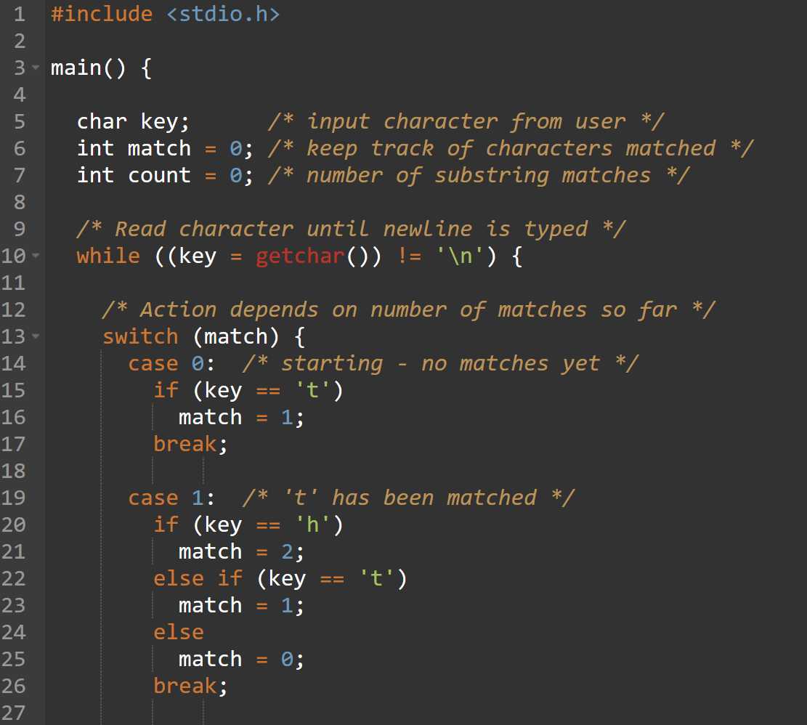
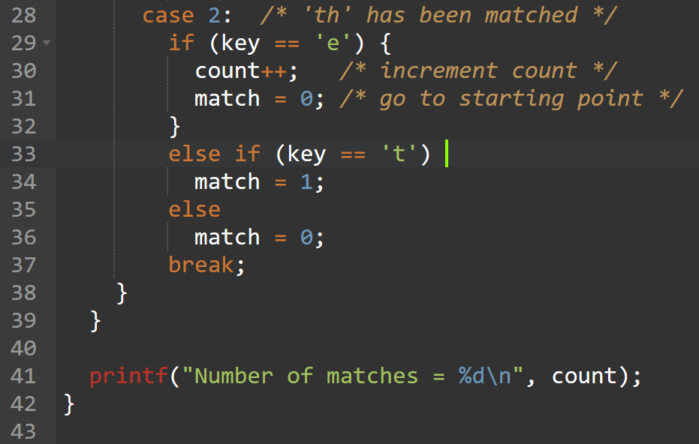
Substring: Code (Part 1)

Slide 89
Break and Continue
break;
used only in switch statement or iteration statement
passes control out of the “smallest” (loop or switch) statement containing it to the statement immediately following
usually used to exit a loop before terminating condition occurs (or to exit switch statement when case is done)
continue;
used only in iteration statement
terminates the execution of the loop body for this iteration
loop expression is evaluated to see whether another iteration should be performed
if for loop, also executes the re-initializer

Slide 90
Example
What does the following loop do?
for (i = 0; i <= 20; i++) { if (i%2 == 0) continue; printf("%d ", i);
}
What would be an easier way to write this?
What happens if break instead of continue?

Slide 91
FUNCTIONS

Slide 92
Function
Smaller, simpler, subcomponent of program
Provides abstraction
hide low-level details
give high-level structure to program, easier to understand overall program flow
enables separable, independent development
C functions
zero or multiple arguments passed in
single result returned (optional)
return value is always a particular type
In other languages, called procedures, subroutines, ...

Slide 93
Example of High-Level Structure
main() { SetupBoard(); /* place pieces on board */ DetermineSides(); /* choose black/white */
/* Play game */ do { WhitesTurn(); BlacksTurn(); } while (NoOutcomeYet()); }
Structure of program is evident, even without knowing implementation.

Slide 94
Functions in C
Declaration (also called prototype)
int Factorial(int n);
Function call - used in expression
a = x + Factorial(f + g);
type of return value
name of function
types of argument
1. evaluate arguments
2, execute function
3. use return value in expression

Slide 95
Function Definition
State type, name, types of arguments
must match function declaration
give name to each argument (doesn't have to match declaration)
int Factorial(int n) {
int i; int result = 1; for (i = 1; i <= n; i++) result *= i; return result;
}
gives control back to calling function and returns value

Slide 96
Why Declaration?
Since function definition also includes return and argument types, why is declaration needed?
Use might be seen before definition. Compiler needs to know return and arg types and number of arguments.
Definition might be in a different file, written by a different programmer.
include a "header" file with function declarations only
compile separately, link together to make executable

Slide 97
Example
double ValueInDollars(double amount, double rate);
main() { ... dollars = ValueInDollars(francs,DOLLARS_PER_FRANC); printf("%f francs equals %f dollars.\n", francs, dollars); ...
}
double ValueInDollars(double amount, double rate) {
return amount * rate;
}
declaration
function call (invocation)
definition

Slide 98
Implementing Functions: Overview
Activation record
information about each function, including arguments and local variables
stored on run-time stack
Calling function
push new activation record copy values into arguments call function
Called function
execute code put result in activation record
pop activation record from stack return
get result from stack

Slide 99
Run-Time Stack
Recall that local variables are stored on the run-time stack in an activation record
Frame pointer (R5) points to the beginning of a region of activation record that stores local variables for the current function
When a new function is called, its activation record is pushed on the stack;
When it returns, its activation record is popped off of the stack.

Slide 100
Run-Time Stack
Memory
Memory
Memory
R6
Watt
R5
R6
R6
R5
main
R5
main
main
Before call
During call
After call

Slide 101
DATA STRUCTURES:
Intro

Slide 102
Data Structures
A data structure is a particular organization of data in memory.
We want to group related items together.
We want to organize these data bundles in a way that is convenient to program and efficient to execute.
An array is one kind of data structure.
In this chapter, we look at two more:
struct – directly supported by C
linked list – built from struct and dynamic allocation

Slide 103
DATA STRUCTURES:
Pointers

Slide 104
Data Structures
A data structure is a particular organization of data in memory.
We want to group related items together.
We want to organize these data bundles in a way that is convenient to program and efficient to execute.
An array is one kind of data structure.
In this chapter, we look at two more:
struct – directly supported by C
linked list – built from struct and dynamic allocation

Slide 105
Pointers and Arrays
We've seen examples of both of these in our LC-3 programs; now we'll see them in C.
Pointer
Address of a variable in memory
Allows us to indirectly access variables
in other words, we can talk about its address rather than its value
Array
A list of values arranged sequentially in memory
Example: a list of telephone numbers
Expression a[4] refers to the 5th element of the array a

Slide 106
Address vs. Value
Sometimes we want to deal with the address of a memory location, rather than the value it contains.
Recall example from Chapter 6: adding a column of numbers.
R2 contains address of first location.
Read value, add to sum, and increment R2 until all numbers have been processed.
R2 is a pointer -- it contains the address of data we’re interested in.
address
value
x3107
x3100
x2819
x3101
R2
x3100
x0110
x3102
x0310
x3103
x0100
x3104
x1110
x3105
x11B1
x3106
x0019
x3107

Slide 107
Another Need for Addresses
Consider the following function that's supposed to swap the values of its arguments.
void Swap(int firstVal, int secondVal) { int tempVal = firstVal; firstVal = secondVal; secondVal = tempVal; }

Slide 108
Executing the Swap Function
before call
after call
firstVal
secondVal
valueB
valueA
tempVal
firstVal
secondVal
valueB
valueA
These values
changed...
3
4
4
3
3
4
3
4
3
Swap
R6
R6
main
...but these
did not.
Swap needs addresses of variables outside its own activation record.

Slide 109
Pointers in C
C lets us talk about and manipulate pointers as variables and in expressions.
Declaration
int *p; /* p is a pointer to an int */
A pointer in C is always a pointer to a particular data type: int*, double*, char*, etc.
Operators
*p -- returns the value pointed to by p
&z -- returns the address of variable z

Slide 110
Example
int i;
int *ptr;
i = 4;
ptr = &i;
*ptr = *ptr + 1;
store the value 4 into the memory location
associated with i
store the address of i into the memory location associated with ptr
read the contents of memory at the address stored in ptr
store the result into memory
at the address stored in ptr

Slide 111
Example: LC-3 Code
; i is 1st local (offset 0), ptr is 2nd (offset -1)
; i = 4;
AND R0, R0, #0 ; clear R0 ADD R0, R0, #4 ; put 4 in R0 STR R0, R5, #0 ; store in i ; ptr = &i; ADD R0, R5, #0 ; R0 = R5 + 0 (addr of i) STR R0, R5, #-1 ; store in ptr
; *ptr = *ptr + 1; LDR R0, R5, #-1 ; R0 = ptr LDR R1, R0, #0 ; load contents (*ptr) ADD R1, R1, #1 ; add one STR R1, R0, #0 ; store result where R0 points

Slide 112
Pointers as Arguments
Passing a pointer into a function allows the function to read/change memory outside its activation record.
void NewSwap(int *firstVal, int *secondVal) { int tempVal = *firstVal; *firstVal = *secondVal; *secondVal = tempVal; }
Arguments are integer pointers.
Caller passes addresses of variables that it wants function to change.

Slide 113
Passing Pointers to a Function
main() wants to swap the values of valueA and valueB
passes the addresses to NewSwap:
NewSwap(&valueA, &valueB);
Code for passing arguments:
ADD R0, R5, #-1 ; addr of valueB ADD R6, R6, #-1 ; push STR R0, R6, #0 ADD R0, R5, #0 ; addr of valueA ADD R6, R6, #-1 ; push STR R0, R6, #0
xEFFA
xEFF9
4
3
tempVal
firstVal
secondVal
valueB
valueA
R6
R5
xEFFD

Slide 114
Code Using Pointers
Inside the NewSwap routine
; int tempVal = *firstVal; LDR R0, R5, #4 ; R0=xEFFA LDR R1, R0, #0 ; R1=M[xEFFA]=3 STR R1, R5, #4 ; tempVal=3 ; *firstVal = *secondVal; LDR R1, R5, #5 ; R1=xEFF9 LDR R2, R1, #0 ; R1=M[xEFF9]=4 STR R2, R0, #0 ; M[xEFFA]=4 ; *secondVal = tempVal;
LDR R2, R5, #0 ; R2=3 STR R2, R1, #0 ; M[xEFF9]=3
R6
3
xEFFA
xEFF9
3
4
tempVal
firstVal
secondVal
valueB
valueA
R5
xEFFD

Slide 115
Null Pointer
Sometimes we want a pointer that points to nothing.
In other words, we declare a pointer, but we’re not ready to actually point to something yet.
int *p; p = NULL; /* p is a null pointer */
NULL is a predefined macro that contains a value that a non-null pointer should never hold.
Often, NULL = 0, because Address 0 is not a legal address for most programs on most platforms.

Slide 116
Using Arguments for Results
Pass address of variable where you want result stored
useful for multiple results Example: return value via pointer return status code as function result
This solves the mystery of why ‘&’ with argument to scanf:
scanf("%d ", &dataIn);
read a decimal integer and store in dataIn

Slide 117
Syntax for Pointer Operators
Declaring a pointer
type *var; type* var;
Either of these work -- whitespace doesn't matter. Type of variable is int* (integer pointer), char* (char pointer), etc.
Creating a pointer
&var
Must be applied to a memory object, such as a variable. In other words, &3 is not allowed.
Dereferencing Can be applied to any expression. All of these are legal: *var contents of mem loc pointed to by var
**var contents of mem loc pointed to by memory location pointed to by var
*3 contents of memory location 3

Slide 118
Example using Pointers
IntDivide performs both integer division and remainder, returning results via pointers. (Returns –1 if divide by zero.)
int IntDivide(int x, int y, int *quoPtr, int *remPtr); main() {
int dividend, divisor; /* numbers for divide op */ int quotient, remainer; /* results */ int error; /* ...code for dividend, divisor input removed... */ error = IntDivide(dividend, divisor, &quotient, &remainder); /* ...remaining code removed... */ }

Slide 119
C Code for IntDivide
int IntDivide(int x, int y, int *quoPtr, int *remPtr) { if (y != 0) { *quoPtr = x / y; /* quotient in *quoPtr */ *remPtr = x % y; /* remainder in *remPtr */ return 0; } else return –1; }

Slide 120
DATA STRUCTURES:
Arrays

Slide 121
Arrays
How do we allocate a group of memory locations?
character string
table of numbers
How about this?
Not too bad, but…
what if there are 100 numbers?
how do we write a loop to process each number?
Fortunately, C gives us a better way -- the array.
int num[4];
Declares a sequence of four integers, referenced by: num[0], num[1], num[2], num[3].
int num0; int num1; int num2; int num3;

Slide 122
Array Syntax
Declaration
type variable[num_elements];
Array Reference
variable[index];
all array elements
are of the same type
number of elements must be known at compile-time
i-th element of array (starting with zero);
no limit checking at compile-time or run-time

Slide 123
Array as a Local Variable
Array elements are allocated as part of the activation record.
int grid[10];
First element (grid[0]) is at lowest address of allocated space. If grid is first variable allocated, then R5 will point to grid[9].
grid[0]
grid[1]
grid[2]
grid[3]
grid[4]
grid[5]
grid[6]
grid[7]
grid[8]
grid[9]

Slide 124
Passing Arrays as Arguments
C passes arrays by reference
the address of the array (i.e., of the first element) is written to the function's activation record
otherwise, would have to copy each element
main() {
int numbers[MAX_NUMS];
… mean = Average(numbers);
… }
int Average(int inputValues[MAX_NUMS]) {
…
for (index = 0; index < MAX_NUMS; index++) sum = sum + indexValues[index]; return (sum / MAX_NUMS);
}
This must be a constant, e.g., #define MAX_NUMS 10

Slide 125
A String is an Array of Characters
Allocate space for a string just like any other array:
char outputString[16];
Space for string must contain room for terminating zero.
Special syntax for initializing a string:
char outputString[16] = "Result = ";
…which is the same as:
outputString[0] = 'R'; outputString[1] = 'e'; outputString[2] = 's'; ...

Slide 126
I/O with Strings
Printf and scanf use "%s" format character for string
Printf -- print characters up to terminating zero
printf("%s", outputString);
Scanf -- read characters until whitespace, store result in string, and terminate with zero
scanf("%s", inputString);

Slide 127
Relationship between Arrays & Pointers
An array name is essentially a pointer to the first element in the array char word[10]; char *cptr; cptr = word; /* points to word[0] */
Difference: Can change the contents of cptr, as in
cptr = cptr + 1;
(The identifier "word" is not a variable.)

Slide 128
Correspondence: Pointers & Arrays
Given the declarations on the previous page, each line below gives three equivalent expressions:
cptr word &word[0]
(cptr + n) word + n &word[n]
*cptr *word word[0]
*(cptr + n) *(word + n) word[n]

Slide 129
Common Pitfalls with Arrays in C
Overrun array limits
There is no checking at run-time or compile-time to see whether reference is within array bounds.
int array[10]; int i; for (i = 0; i <= 10; i++) array[i] = 0;
Declaration with variable size
Size of array must be known at compile time.
void SomeFunction(int num_elements) { int temp[num_elements]; … }

Slide 130
Pointer Arithmetic
Address calculations depend on size of elements
In our LC-3 code, we've been assuming one word per element.
e.g., to find 4th element, we add 4 to base address
It's ok, because we've only shown code for int and char, both of which take up one word.
If double, we'd have to add 8 to find address of 4th element.
C does size calculations under the covers, depending on size of item being pointed to:
double x[10];
double *y = x; *(y + 3) = 13;
allocates 20 words (2 per element)
same as x[3] -- base address plus 6

Slide 131
DATA STRUCTURES:
Structs

Slide 132
Structures in C
A struct is a mechanism for grouping together related data items of different types.
Recall that an array groups items of a single type.
Example: We want to represent an airborne aircraft:
char flightNum[7]; int altitude; int longitude; int latitude; int heading; double airSpeed;
We can use a struct to group these data together for each plane.

Slide 133
Defining a Struct
We first need to define a new type for the compiler and tell it what our struct looks like.
struct flightType { char flightNum[7]; /* max 6 characters */ int altitude; /* in meters */ int longitude; /* in tenths of degrees */ int latitude; /* in tenths of degrees */ int heading; /* in tenths of degrees */ double airSpeed; /* in km/hr */
};
This tells the compiler how big our struct is and how the different data items (“members”) are laid out in memory.
But it does not allocate any memory.

Slide 134
Declaring and Using a Struct
To allocate memory for a struct, we declare a variable using our new data type.
struct flightType plane;
Memory is allocated, and we can access individual members of this variable:
plane.airSpeed = 800.0; plane.altitude = 10000;
A struct’s members are laid out in the order specified by the definition.
plane.flightNum[0]
plane.flightNum[6]
plane.altitude
plane.longitude
plane.latitude
plane.heading
plane.airspeed

Slide 135
Defining and Declaring at Once
You can both define and declare a struct at the same time.
struct flightType { char flightNum[7]; /* max 6 characters */ int altitude; /* in meters */ int longitude; /* in tenths of degrees */ int latitude; /* in tenths of degrees */ int heading; /* in tenths of degrees */ double airSpeed; /* in km/hr */
} maverick;
And you can use the flightType name to declare other structs.
struct flightType iceMan;

Slide 136
typedef
C provides a way to define a data type by giving a new name to a predefined type.
Syntax:
typedef <type> <name>;
Examples:
typedef int Color;
typedef struct flightType WeatherData;
typedef struct ab_type { int a; double b; } ABGroup;

Slide 137
Using typedef
This gives us a way to make code more readable by giving application-specific names to types.
Color pixels[500];
Flight plane1, plane2;
Typical practice:
Put typedef’s into a header file, and use type names in main program. If the definition of Color/Flight changes, you might not need to change the code in your main program file.

Slide 138
Generating Code for Structs
Suppose our program starts out like this:
int x; Flight plane; int y; plane.altitude = 0;
...
LC-3 code for this assignment:
AND R1, R1, #0 ADD R0, R5, #-13 ; R0=plane STR R1, R0, #7 ; 8th word
y
plane.flightNum[0]
plane.flightNum[6]
plane.altitude
plane.longitude
plane.latitude
plane.heading
plane.airspeed
x
R5

Slide 139
Array of Structs
Can declare an array of structs:
Flight planes[100];
Each array element is a struct (7 words, in this case).
To access member of a particular element:
planes[34].altitude = 10000;
Because the [] and . operators are at the same precedence, and both associate left-to-right, this is the same as:
(planes[34]).altitude = 10000;

Slide 140
Pointer to Struct
We can declare and create a pointer to a struct:
Flight *planePtr; planePtr = &planes[34];
To access a member of the struct addressed by dayPtr:
(*planePtr).altitude = 10000;
Because the . operator has higher precedence than *, this is NOT the same as:
*planePtr.altitude = 10000;
C provides special syntax for accessing a struct member through a pointer:
planePtr->altitude = 10000;

Slide 141
Passing Structs as Arguments
Unlike an array, a struct is always passed by value into a function.
This means the struct members are copied to the function’s activation record, and changes inside the function are not reflected in the calling routine’s copy.
Most of the time, you’ll want to pass a pointer to a struct.
int Collide(Flight *planeA, Flight *planeB) { if (planeA->altitude == planeB->altitude) { ... } else return 0; }

Slide 142
DATA STRUCTURES:
Linked Lists

Slide 143
The Linked List Data Structure
A linked list is an ordered collection of nodes each of which contains some data, connected using pointers.
Each node points to the next node in the list.
The first node in the list is called the head.
The last node in the list is called the tail.
Node 0
Node 1
Node 2
NULL

Slide 144
Linked List vs. Array
A linked list can only be accessed sequentially.
To find the 5th element, for instance, you must start from the head and follow the links through four other nodes.
Advantages of linked list:
Dynamic size
Easy to add additional nodes as needed
Easy to add or remove nodes from the middle of the list (just add or redirect links)
Advantage of array:
Can easily and quickly access arbitrary elements

Slide 145
Example: Car Lot
Create an inventory database for a used car lot. Support the following actions:
Search the database for a particular vehicle.
Add a new car to the database.
Delete a car from the database.
The database must remain sorted by vehicle ID.
Since we don’t know how many cars might be on the lot at one time, we choose a linked list representation.

Slide 146
Car data structure
Each car has the following characterics: vehicle ID, make, model, year, mileage, cost.
Because it’s a linked list, we also need a pointer to the next node in the list:
typedef struct carType Car; struct carType { int vehicleID; char make[20]; char model[20]; int year; int mileage; double cost; Car *next; /* ptr to next car in list */ }

Slide 147
Scanning the List
Searching, adding, and deleting all require us to find a particular node in the list. We scan the list until we find a node whose ID is >= the one we’re looking for.
Car *ScanList(Car *head, int searchID) { Car *previous, *current; previous = head; current = head->next; /* Traverse until ID >= searchID */ while ((current!=NULL) && (current->vehicleID < searchID)) { previous = current; current = current->next; } return previous; }

Slide 148
Adding a Node
Create a new node with the proper info. Find the node (if any) with a greater vehicleID. “Splice” the new node into the list:
new node
Node 0
Node 1
Node 2
NULL

Slide 149
Excerpts from Code to Add a Node
newNode = (Car*) malloc(sizeof(Car)); /* initialize node with new car info */ ... prevNode = ScanList(head, newNode->vehicleID); nextNode = prevNode->next; if ((nextNode == NULL) || (nextNode->vehicleID != newNode->vehicleID)) prevNode->next = newNode; newNode->next = nextNode; } else { printf(“Car already exists in database.”); free(newNode); }

Slide 150
Deleting a Node
Find the node that points to the desired node. Redirect that node’s pointer to the next node (or NULL). Free the deleted node’s memory.
Node 0
Node 1
Node 2
NULL

Slide 151
Excerpts from Code to Delete a Node
printf(“Enter vehicle ID of car to delete:\n”); scanf(“%d”, vehicleID); prevNode = ScanList(head, vehicleID); delNode = prevNode->next; if ((delNode != NULL) && (delNode->vehicleID == vehicleID)) prevNode->next = delNode->next; free(delNode); } else { printf(“Vehicle not found in database.\n”); }

Slide 152
Building on Linked Lists
The linked list is a fundamental data structure.
Dynamic
Easy to add and delete nodes
The concepts described here will be helpful when learning about more elaborate data structures:
Trees
Hash Tables
Directed Acyclic Graphs
...

Slide 153
DATA STRUCTURES:
Dynamic Allocation

Slide 154
Dynamic Allocation
Suppose we want our weather program to handle a variable number of planes – as many as the user wants to enter.
We can’t allocate an array, because we don’t know the maximum number of planes that might be required.
Even if we do know the maximum number, it might be wasteful to allocate that much memory because most of the time only a few planes’ worth of data is needed.
Solution: Allocate storage for data dynamically, as needed.

Slide 155
malloc
The Standard C Library provides a function for allocating memory at run-time: malloc.
void *malloc(int numBytes);
It returns a generic pointer (void*) to a contiguous region of memory of the requested size (in bytes).
The bytes are allocated from a region in memory called the heap.
The run-time system keeps track of chunks of memory from the heap that have been allocated.

Slide 156
Using malloc
To use malloc, we need to know how many bytes to allocate. The sizeof operator asks the compiler to calculate the size of a particular type.
planes = malloc(n * sizeof(Flight));
We also need to change the type of the return value to the proper kind of pointer – this is called “casting.”
planes = (Flight*) malloc(n* sizeof(Flight));

Slide 157
Example
int airbornePlanes; Flight *planes; printf(“How many planes are in the air?”); scanf(“%d”, &airbornePlanes); planes = (Flight*) malloc(sizeof(Flight) * airbornePlanes); if (planes == NULL) { printf(“Error in allocating the data array.\n”); ... } planes[0].altitude = ...
If allocation fails, malloc returns NULL.
Note: Can use array notation or pointer notation.

Slide 158
free
Once the data is no longer needed, it should be released back into the heap for later use.
This is done using the free function, passing it the same address that was returned by malloc.
void free(void*);
If allocated data is not freed, the program might run out of heap memory and be unable to continue.

Slide 159
RECURSIVE FUNCTIONS

Slide 160
What is Recursion?
A recursive function is one that solves its task by calling itself on smaller pieces of data.
Similar to recurrence function in mathematics.
Like iteration -- can be used interchangeably; sometimes recursion results in a simpler solution.
Example: Running sum ( )
Mathematical Definition:
RunningSum(1) = 1 RunningSum(n) = n + RunningSum(n-1)
Recursive Function:
int RunningSum(int n) { if (n == 1) return 1; else return n + RunningSum(n-1); }

Slide 161
Executing RunningSum
res = RunningSum(4);
return value = 10
RunningSum(4)
return 4 + RunningSum(3);
return value = 6
RunningSum(3)
return 3 + RunningSum(2);
return value = 3
RunningSum(2)
return 2 + RunningSum(1);
return value = 1
RunningSum(1)
return 1;

Slide 162
High-Level Example: Binary Search
Given a sorted set of exams, in alphabetical order, find the exam for a particular student.
1. Look at the exam halfway through the pile.
2. If it matches the name, we're done; if it does not match, then...
3a. If the name is greater (alphabetically), then search the upper half of the stack.
3b. If the name is less than the halfway point, then search the lower half of the stack.

Slide 163
Binary Search: Pseudocode
Pseudocode is a way to describe algorithms without completely coding them in C.
FindExam(studentName, start, end){ halfwayPoint = (end + start)/2; if (end < start) ExamNotFound(); /* exam not in stack */ else if (studentName == NameOfExam(halfwayPoint)) ExamFound(halfwayPoint); /* found exam! */ else if (studentName < NameOfExam(halfwayPoint)) /* search lower half */ FindExam(studentName, start, halfwayPoint - 1); else /* search upper half */ FindExam(studentName, halfwayPoint + 1, end); }

Slide 164
High-Level Example: Towers of Hanoi
Task: Move all disks from current post to another post.
Rules:
(1) Can only move one disk at a time.
(2) A larger disk can never be placed on top of a smaller disk.
(3) May use third post for temporary storage.
Post 1
Post 2
Post 3

Slide 165
Task Decomposition
Suppose disks start on Post 1, and target is Post 3.
1. Move top n-1 disks to Post 2.
2. Move largest disk to Post 3.
3. Move n-1 disks from Post 2 to Post 3.
1
2
3
1
2
3
1
2
3

Slide 166
Task Decomposition (cont.)
Task 1 is really the same problem, with fewer disks and a different target post.
"Move n-1 disks from Post 1 to Post 2."
And Task 3 is also the same problem, with fewer disks and different starting and target posts.
"Move n-1 disks from Post 2 to Post 3."
So this is a recursive algorithm.
The terminal case is moving the smallest disk -- can move directly without using third post.
Number disks from 1 (smallest) to n (largest).

Slide 167
Towers of Hanoi: Pseudocode
MoveDisk(diskNumber, startPost, endPost, midPost) { if (diskNumber > 1) { /* Move top n-1 disks to mid post */ MoveDisk(diskNumber-1, startPost, midPost, endPost); printf("Move disk number %d from %d to %d.\n", diskNumber, startPost, endPost); /* Move n-1 disks from mid post to end post */ MoveDisk(diskNumber-1, midPost, endPost, startPost); } else printf("Move disk number 1 from %d to %d.\n", startPost, endPost); }

Slide 168

Detailed Example: Fibonacci Numbers
Mathematical Definition:
In other words, the n-th Fibonacci number is the sum of the previous two Fibonacci numbers.
$$f(n)=f(n−1)+f(n−2) \\ f(1)=1 \\ f(0)=1$$

Slide 169
Fibonacci: C Code
int Fibonacci(int n) { if ((n == 0) || (n == 1)) return 1; else return Fibonacci(n-1) + Fibonacci(n-2); }

Slide 170
Activation Records
Whenever Fibonacci is invoked, a new activation record is pushed onto the stack.
main calls Fibonacci(3)
Fibonacci(3) calls Fibonacci(2)
Fibonacci(2) calls Fibonacci(1)
R6
Fib(1)
R6
Fib(2)
Fib(2)
R6
Fib(3)
Fib(3)
Fib(3)
main
main
main

Slide 171
Activation Records (cont.)
Fibonacci(1) returns, Fibonacci(2) calls Fibonacci(0)
Fibonacci(2) returns, Fibonacci(3) calls Fibonacci(1)
Fibonacci(3) returns
R6
Fib(0)
R6
Fib(2)
Fib(1)
Fib(3)
Fib(3)
R6
main
main
main

Slide 172
Tracing the Function Calls
If we are debugging this program, we might want to trace all the calls of Fibonacci.
Note: A trace will also contain the arguments passed into the function.
For Fibonacci(3), a trace looks like:
Fibonacci(3) Fibonacci(2) Fibonacci(1) Fibonacci(0) Fibonacci(1)
What would trace of Fibonacci(4) look like?

Slide 173
A Final C Example: Printing an Integer
Recursively converts an unsigned integer as a string of ASCII characters.
If integer <10, convert to char and print.
Else, call self on first (n-1) digits and then print last digit.
void IntToAscii(int num) { int prefix, currDigit; if (num < 10) putchar(num + '0'); /* prints single char */ else { prefix = num / 10; /* shift right one digit */ IntToAscii(prefix); /* print shifted num */ /* then print shifted digit */ currDigit = num % 10; putchar(currDigit + '0'); } }

Slide 174
Trace of IntToAscii
Calling IntToAscii with parameter 12345:
IntToAscii(12345) IntToAscii(1234) IntToAscii(123) IntToAscii(12) IntToAscii(1) putchar('1') putchar('2') putchar('3') putchar('4') putchar('5')

Slide 175
I/O IN C

Slide 176
Standard C Library
I/O commands are not included as part of the C language.
Instead, they are part of the Standard C Library.
A collection of functions and macros that must be implemented by any ANSI standard implementation.
Automatically linked with every executable.
Implementation depends on processor, operating system, etc., but interface is standard.
Since they are not part of the language, compiler must be told about function interfaces.
Standard header files are provided, which contain declarations of functions, variables, etc.

Slide 177
Basic I/O Functions
The standard I/O functions are declared in the <stdio.h> header file.
Function Description
putchar Displays an ASCII character to the screen.
getchar Reads an ASCII character from the keyboard.
printf Displays a formatted string,
scanf Reads a formatted string.
fopen Open/create a file for I/O.
fprintf Writes a formatted string to a file.
fscanf Reads a formatted string from a file.

Slide 178
Text Streams
All character-based I/O in C is performed on text streams.
A stream is a sequence of ASCII characters, such as:
the sequence of ASCII characters printed to the monitor by a single program
the sequence of ASCII characters entered by the user during a single program
the sequence of ASCII characters in a single file
Characters are processed in the order in which they were added to the stream.
E.g., a program sees input characters in the same order as the user typed them.
Standard input stream (keyboard) is called stdin.
Standard output stream (monitor) is called stdout.

Slide 179
Character I/O
putchar(c) Adds one ASCII character (c) to stdout.
getchar() Reads one ASCII character from stdin.
These functions deal with "raw" ASCII characters; no type conversion is performed. char c = 'h';
... putchar(c); putchar('h'); putchar(104);
Each of these calls prints 'h' to the screen.

Slide 180
Buffered I/O
In many systems, characters are buffered in memory during an I/O operation.
Conceptually, each I/O stream has its own buffer.
Keyboard input stream
Characters are added to the buffer only when the newline character (i.e., the "Enter" key) is pressed.
This allows user to correct input before confirming with Enter.
Output stream
Characters are not flushed to the output device until the newline character is added.

Slide 181
Input Buffering
printf("Input character 1:\n"); inChar1 = getchar(); printf("Input character 2:\n"); inChar2 = getchar();
After seeing the first prompt and typing a single character, nothing happens.
Expect to see the second prompt, but character not added to stdin until Enter is pressed.
When Enter is pressed, newline is added to stream and is consumed by second getchar(), so inChar2 is set to'\n'.

Slide 182
Output Buffering
putchar('a'); /* generate some delay */ for (i=0; i<DELAY; i++) sum += i; putchar('b'); putchar('\n');
User doesn't see any character output until after the delay.
'a' is added to the stream before the delay, but the stream is not flushed (displayed) until '\n' is added.

Slide 183
Formatted I/O
Printf and scanf allow conversion between ASCII representations and internal data types.
Format string contains text to be read/written, and formatting characters that describe how data is to be read/written.
%d signed decimal integer %f signed decimal floating-point number %x unsigned hexadecimal number %b unsigned binary number %c ASCII character %s ASCII string

Slide 184
Special Character Literals
Certain characters cannot be easily represented by a single keystroke, because they
correspond to whitespace (newline, tab, backspace, ...)
are used as delimiters for other literals (quote, double quote, ...)
These are represented by the following sequences:
\n newline \t tab \b backspace \\ backslash \' single quote \" double quote \0nnn ASCII code nnn (in octal) \xnnn ASCII code nnn (in hex)

Slide 185
printf
Prints its first argument (format string) to stdout with all formatting characters replaced by the ASCII representation of the corresponding data argument.
int a = 100; int b = 65; char c = 'z'; char banner[10] = "Hola!"; double pi = 3.14159; printf("The variable 'a' decimal: %d\n", a); printf("The variable 'a' hex: %x\n", a); printf("The variable 'a' binary: %b\n", a); printf("'a' plus 'b' as character: %c\n", a+b); printf("A char %c.\t A string %s\n A float %f\n", c, banner, pi);

Slide 186
Missing Data Arguments
What happens when you don't provide a data argument for every formatting character?
printf("The value of nothing is %d\n");
%d will convert and print whatever is on the stack in the position where it expects the first argument. In other words, something will be printed, but it will be a garbage value as far as our program is concerned.

Slide 187
scanf
Reads ASCII characters from stdin, matching characters to its first argument (format string), converting character sequences according to any formatting characters, and storing the converted values to the addresses specified by its data pointer arguments.
char name[100]; int bMonth, bDay, bYear; double gpa; scanf("%s %d/%d/%d %lf", name, &bMonth, &bDay, &bYear, &gpa);

Slide 188
scanf Conversion
For each data conversion, scanf will skip whitespace characters and then read ASCII characters until it encounters the first character that should NOT be included in the converted value.
%d Reads until first non-digit.
%x Reads until first non-digit (in hex).
%s Reads until first whitespace character.
Literals in format string must match literals in the input stream.
Data arguments must be pointers, because scanf stores the converted value to that memory address.

Slide 189
scanf Return Value
The scanf function returns an integer, which indicates the number of successful conversions performed.
This lets the program check whether the input stream was in the proper format.
Example: scanf("%s %d/%d/%d %lf", name, &bMonth, &bDay, &bYear, &gpa);
Input Stream Return Value Mudd 02/16/69 3.02 5
Muss 02 16 69 3.02 2
Doesn't match literal '/', so scanf quits after second conversion.

Slide 190
Bad scanf Arguments
Two problems with scanf data arguments
1. Not a pointer
int n = 0; scanf("%d", n);
Will use the value of the argument as an address.
2. Missing data argument
scanf("%d");
Will get address from stack, where it expects to find first data argument.
If you're lucky, program will crash because of trying to modify a restricted memory location (e.g., location 0). Otherwise, your program will just modify an arbitrary memory location, which can cause very unpredictable behavior.

Slide 191
Variable Argument Lists
The number of arguments in a printf or scanf call depends on the number of data items being read or written.
Declaration of printf (from stdio.h):
int printf(const char*, ...);
Recall calling sequence from Chapter 14
Parameters pushed onto stack from right to left.
This stack-based calling convention allows for a variable number of arguments, and fixed arguments (which are named first) are always the same offset from the frame ptr.

Slide 192
File I/O
For our purposes, a file is a sequence of ASCII characters stored on some device.
Allows us to process large amounts of data without having to type it in each time or read it all on the screen as it scrolls by.
Each file is associated with a stream.
May be input stream or output stream (or both!).
The type of a stream is a "file pointer", declared as: FILE *infile;
The FILE type is defined in <stdio.h>.

Slide 193
fopen
The fopen (pronounced "eff-open") function associates a physical file with a stream.
FILE *fopen(char* name, char* mode);
First argument: name
The name of the physical file, or how to locate it on the storage device. This may be dependent on the underlying operating system.
Second argument: mode
How the file will be used: "r" -- read from the file "w" -- write, starting at the beginning of the file "a" -- write, starting at the end of the file (append)

Slide 194
fprintf and fscanf
Once a file is opened, it can be read or written using fscanf() and fprintf(), respectively.
These are just like scanf() and printf(), except an additional argument specifies a file pointer.
fprintf(outfile, "The answer is %d\n", x);
fscanf(infile, "%s %d/%d/%d %lf", name, &bMonth, &bDay, &bYear, &gpa);

